Slide 1
Firmware
Over The Air (FOTA)
Supervised By
Prof. Dr. Salah Shaban Prof. Dr. Mohamed Badawy

Slide 2
Agenda
01
Introduction
02
System Overview
03
WEB
04
Security

Slide 3
Agenda
05
Server
06
CAN Protocol
07
Bootloader
08
Main ECU

Slide 4
Agenda
09
USER INTERFACE
10
Application ECU
11
Hardware Implementation
12
Future Work

Slide 5
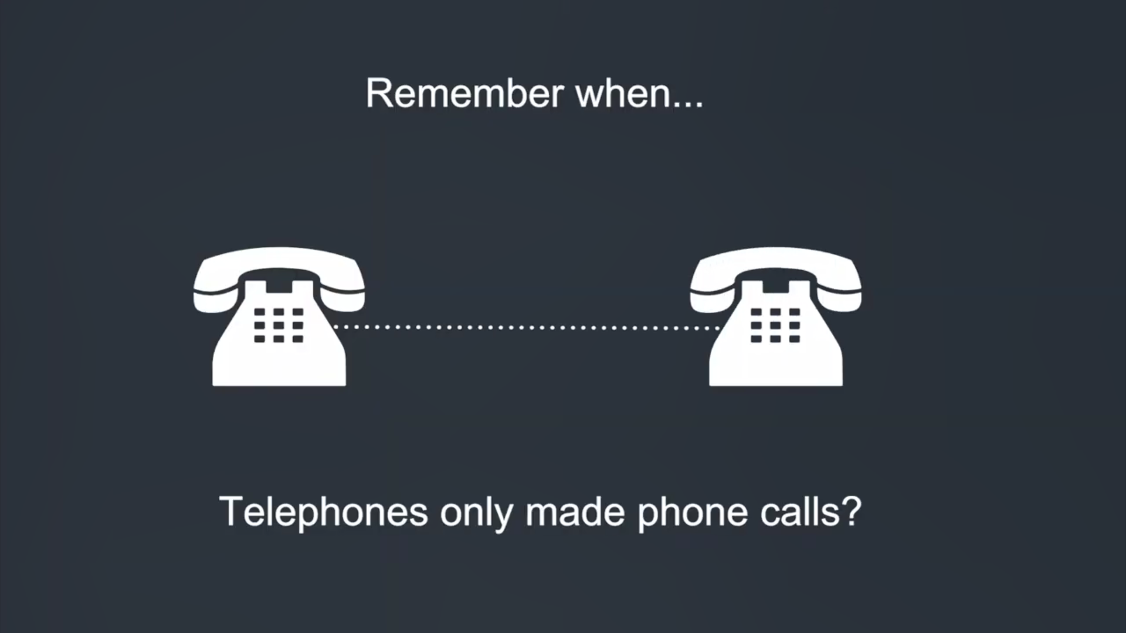
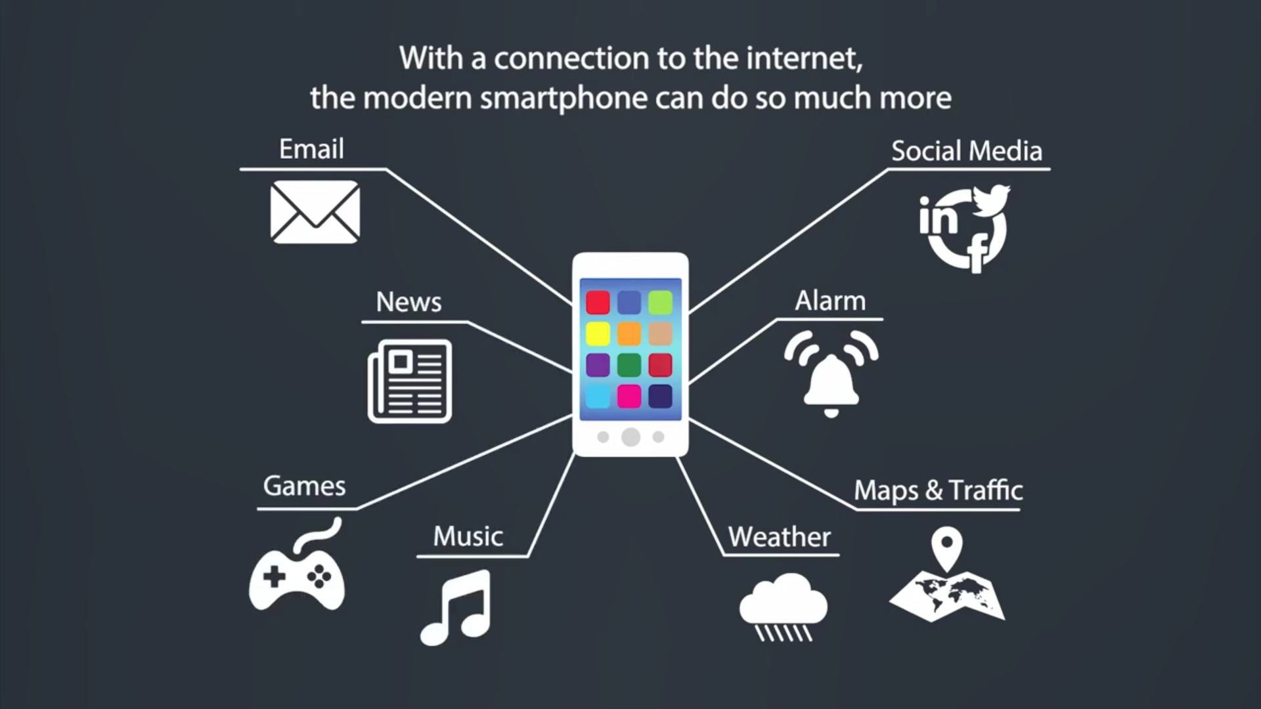
Introduction

Slide 6
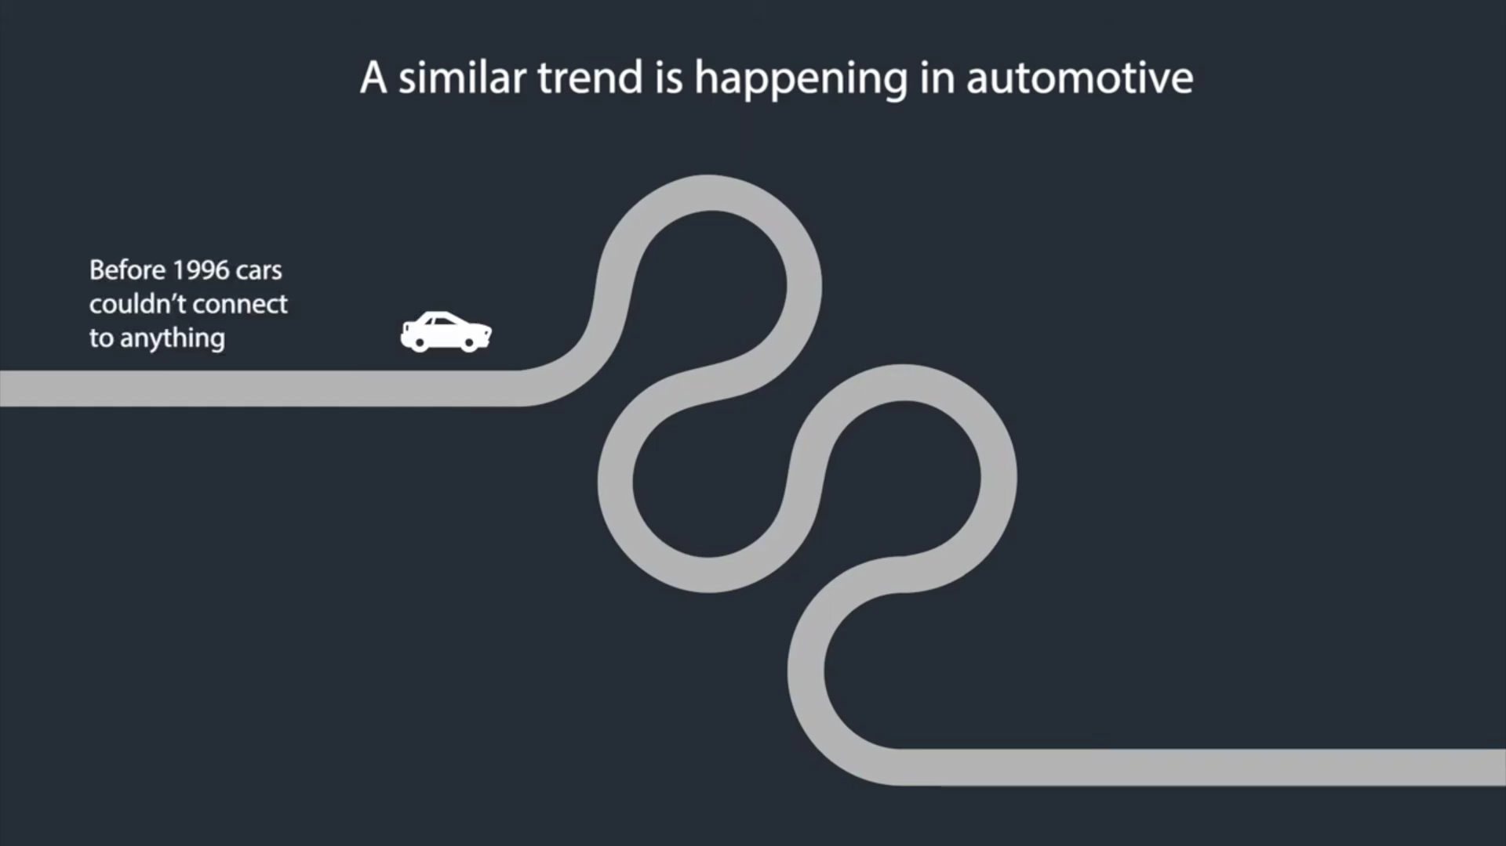
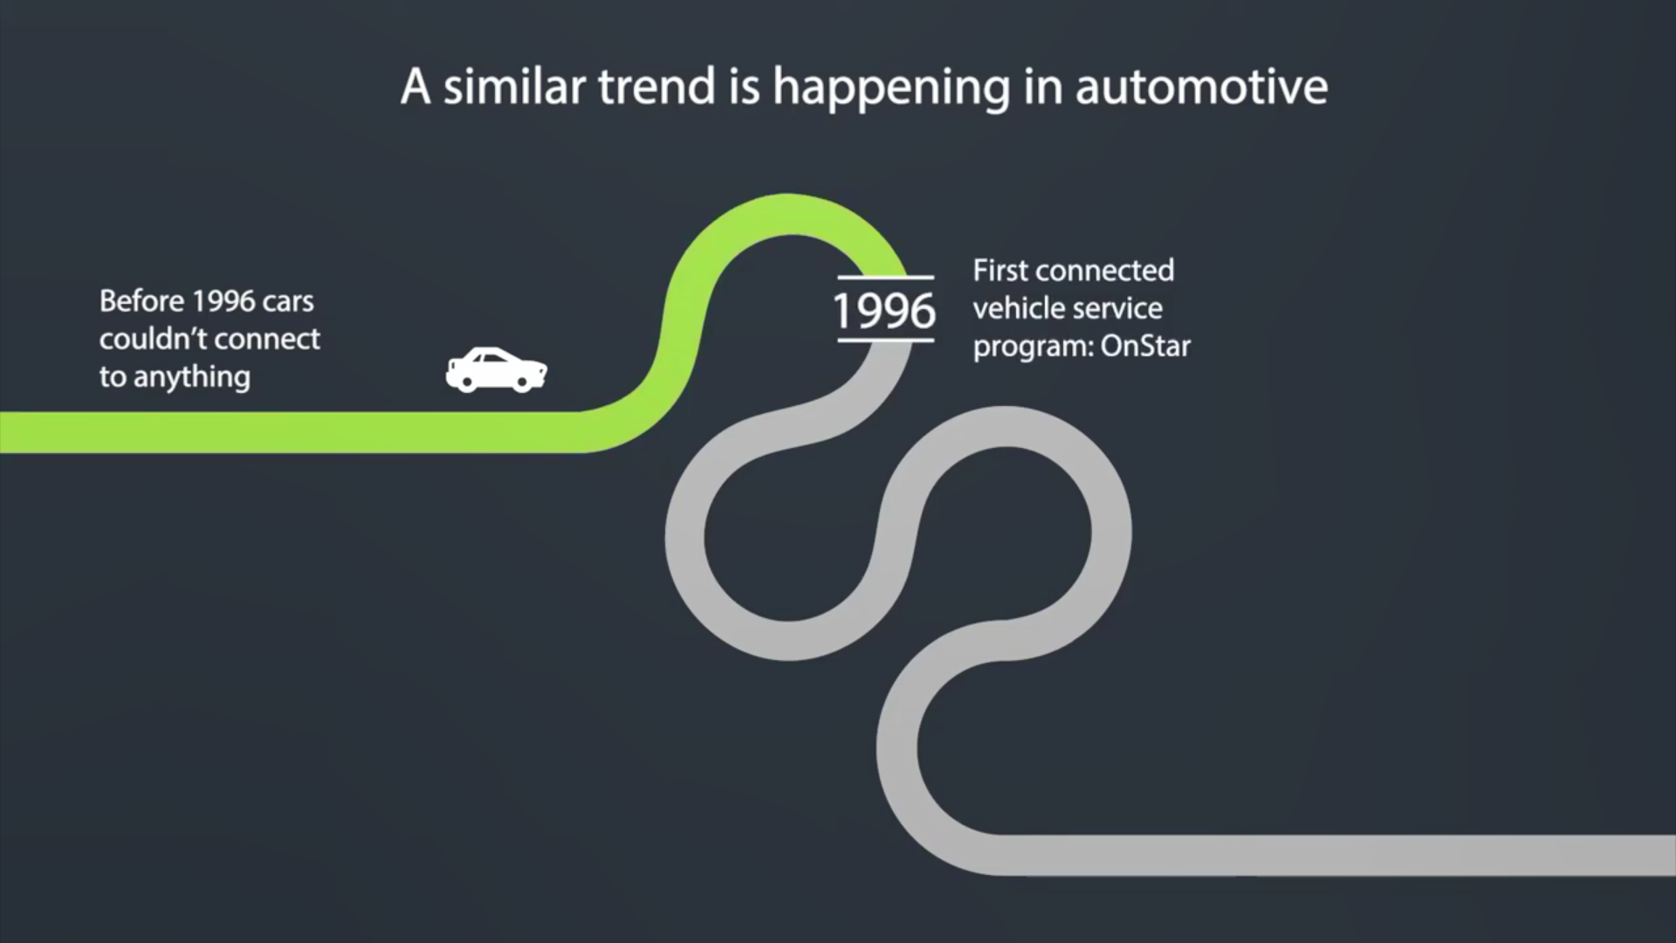
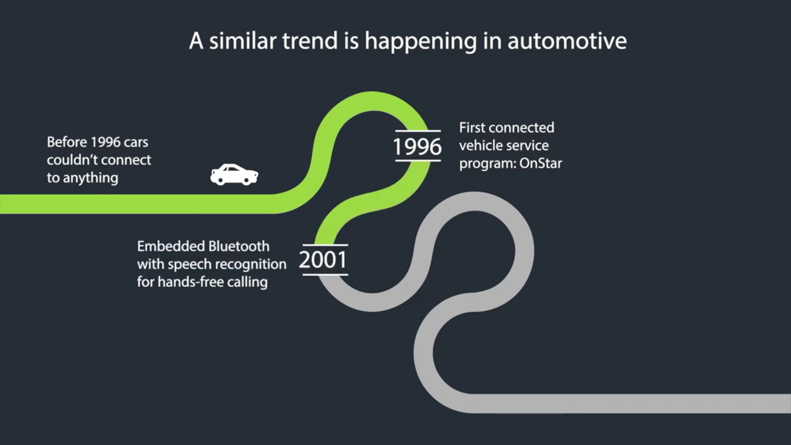
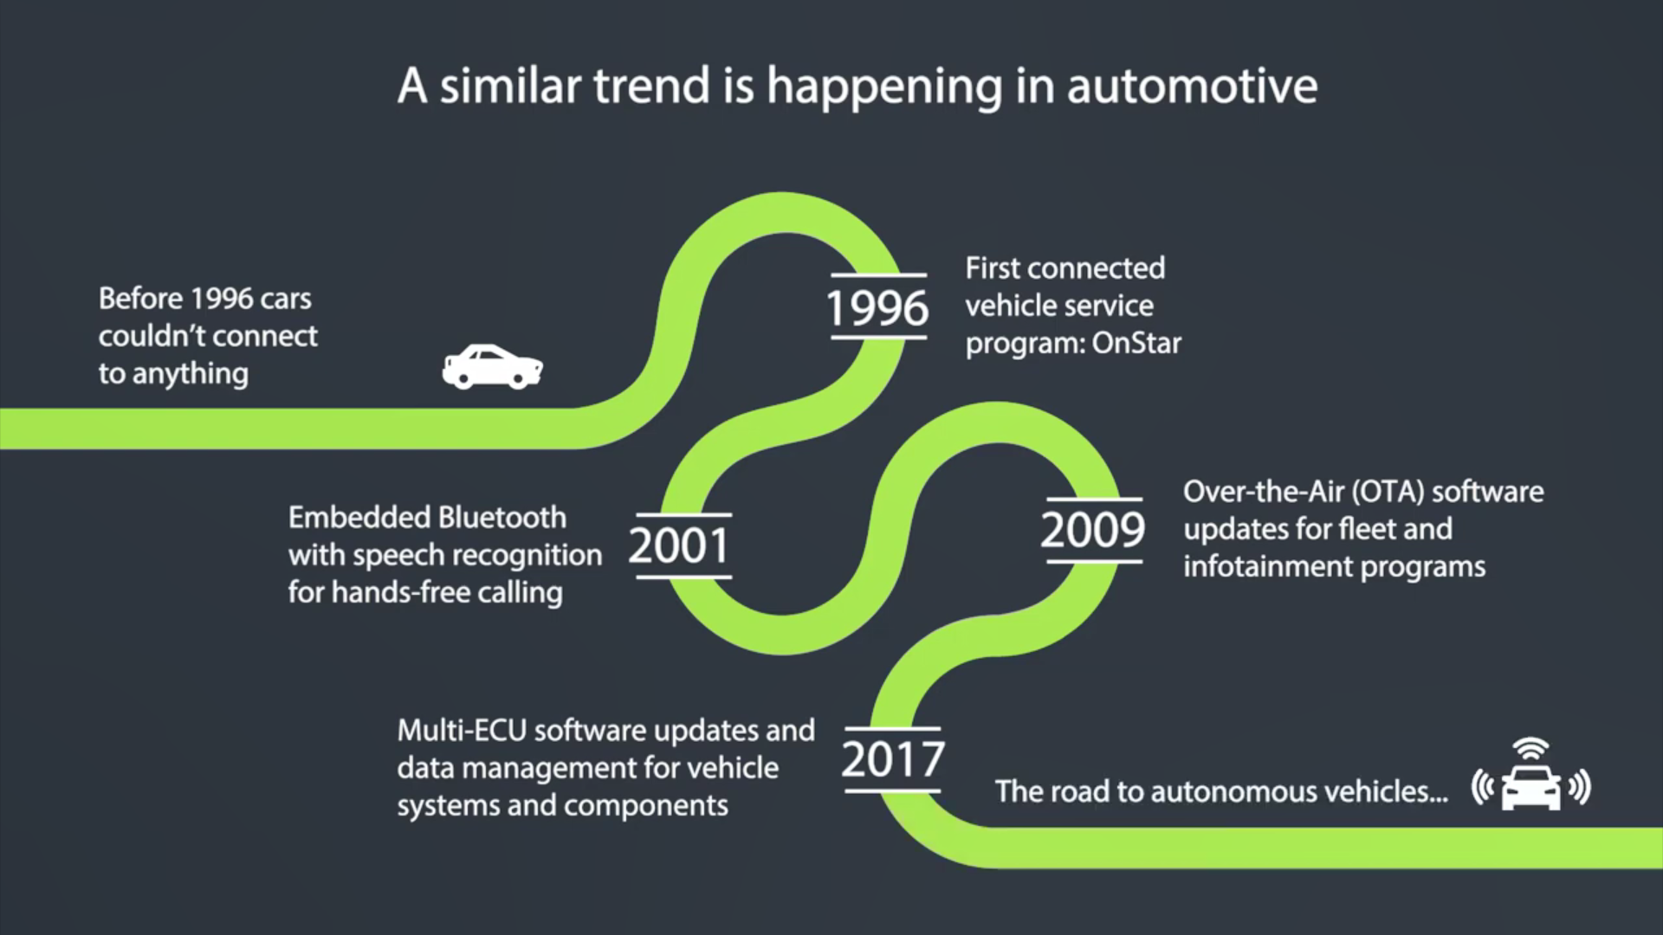
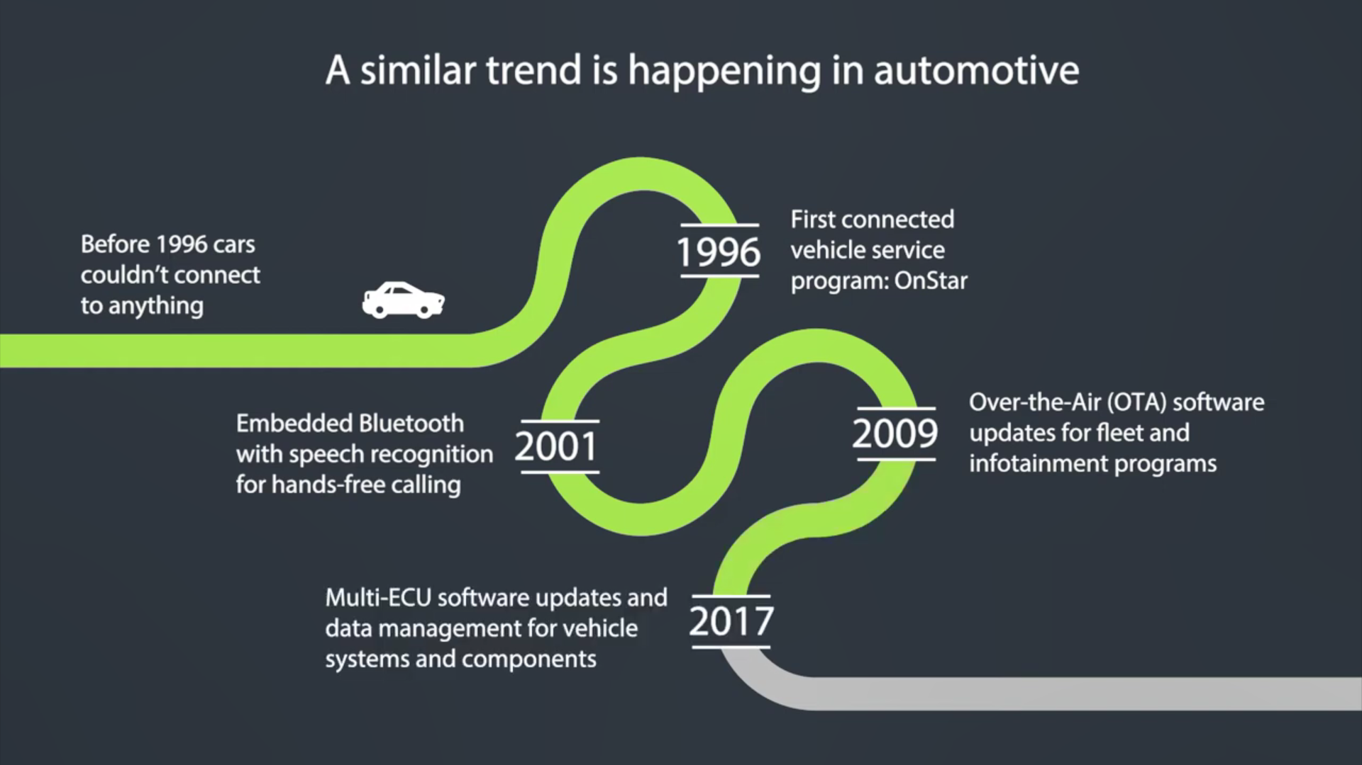
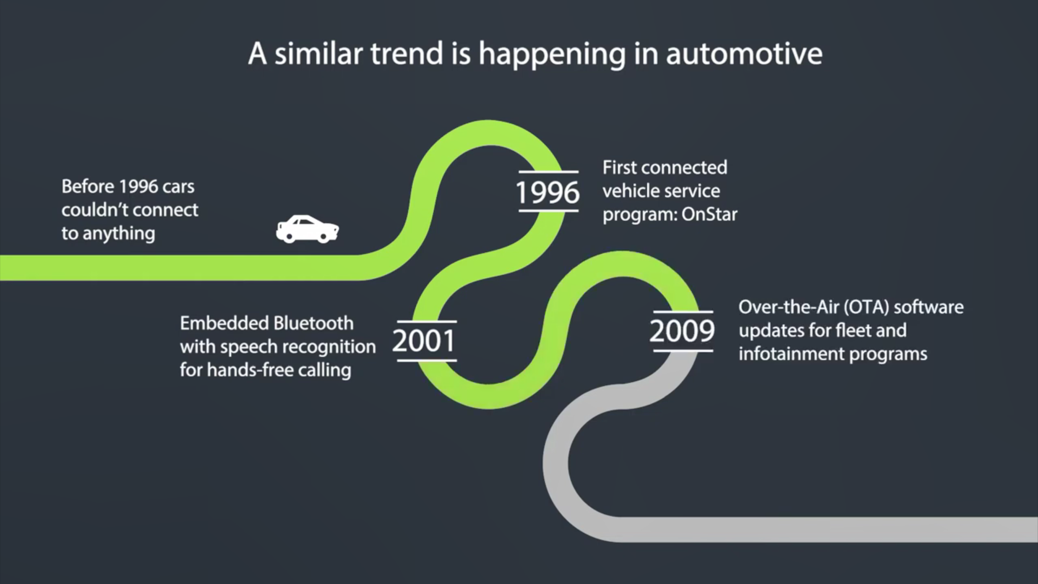
Introduction

Slide 7
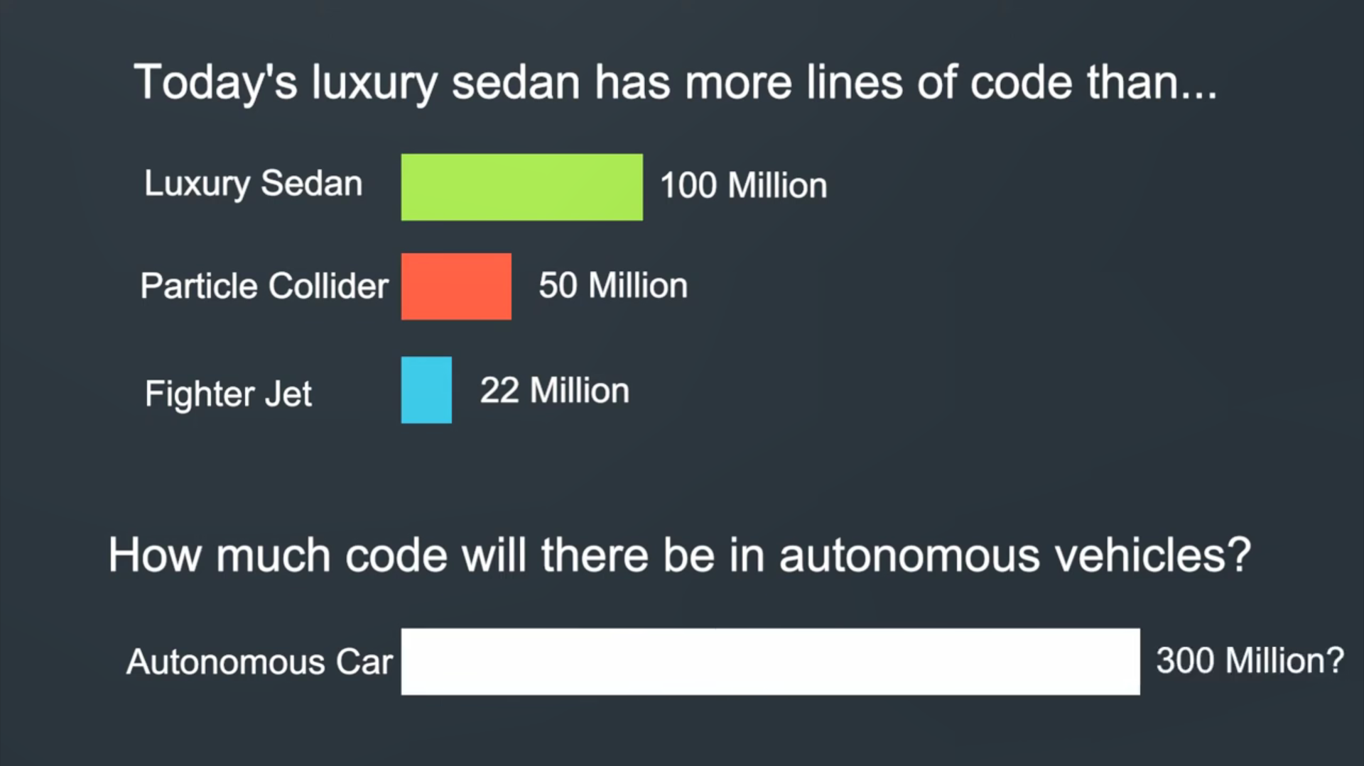
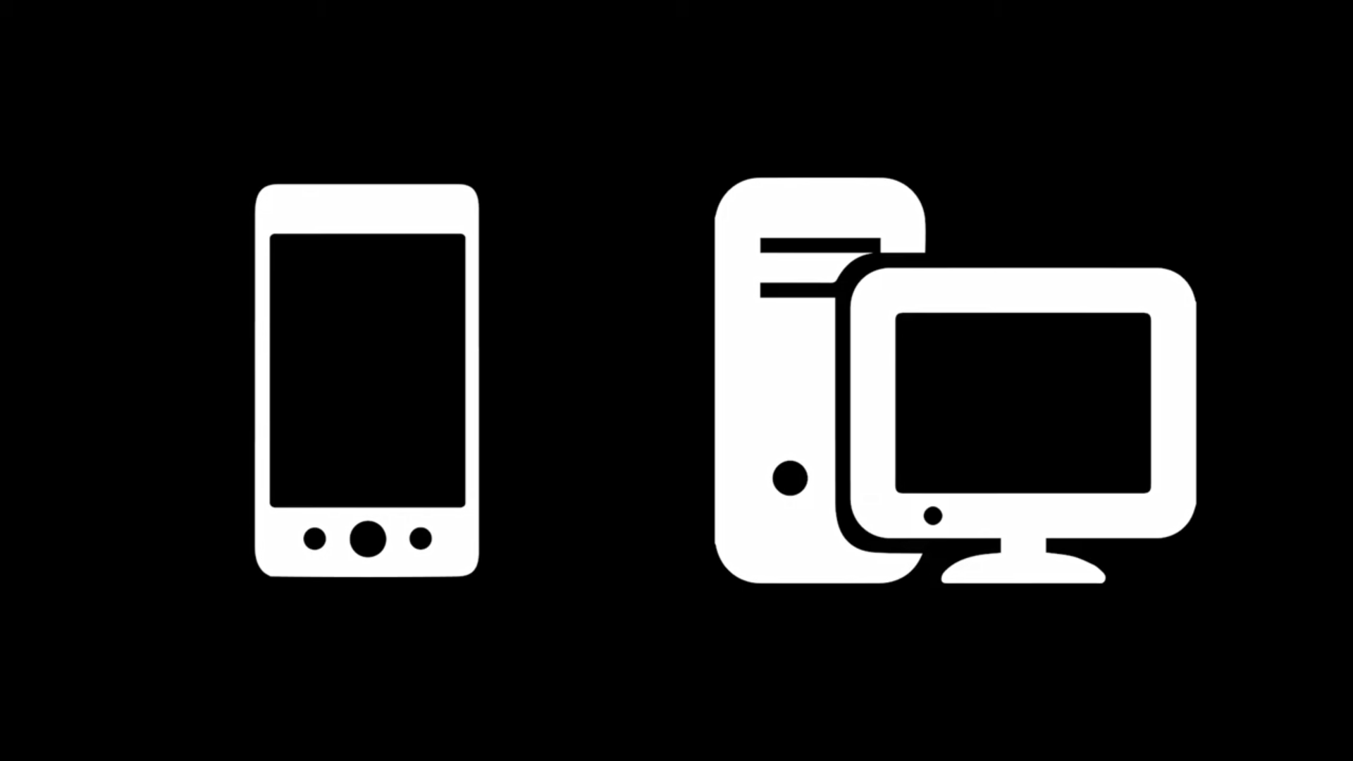
Introduction

Slide 8
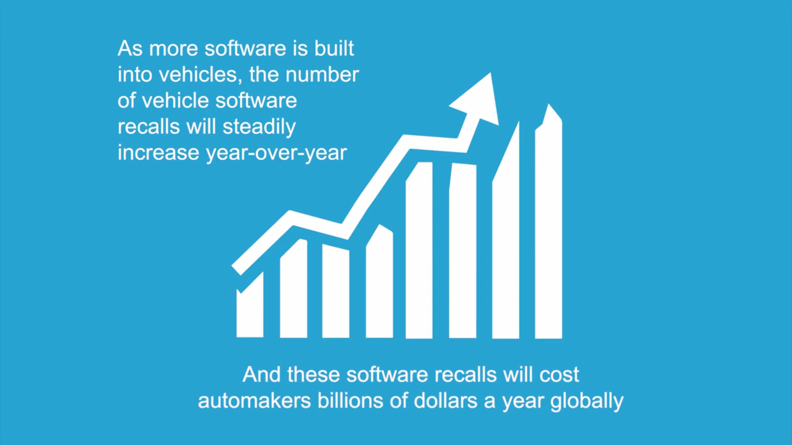
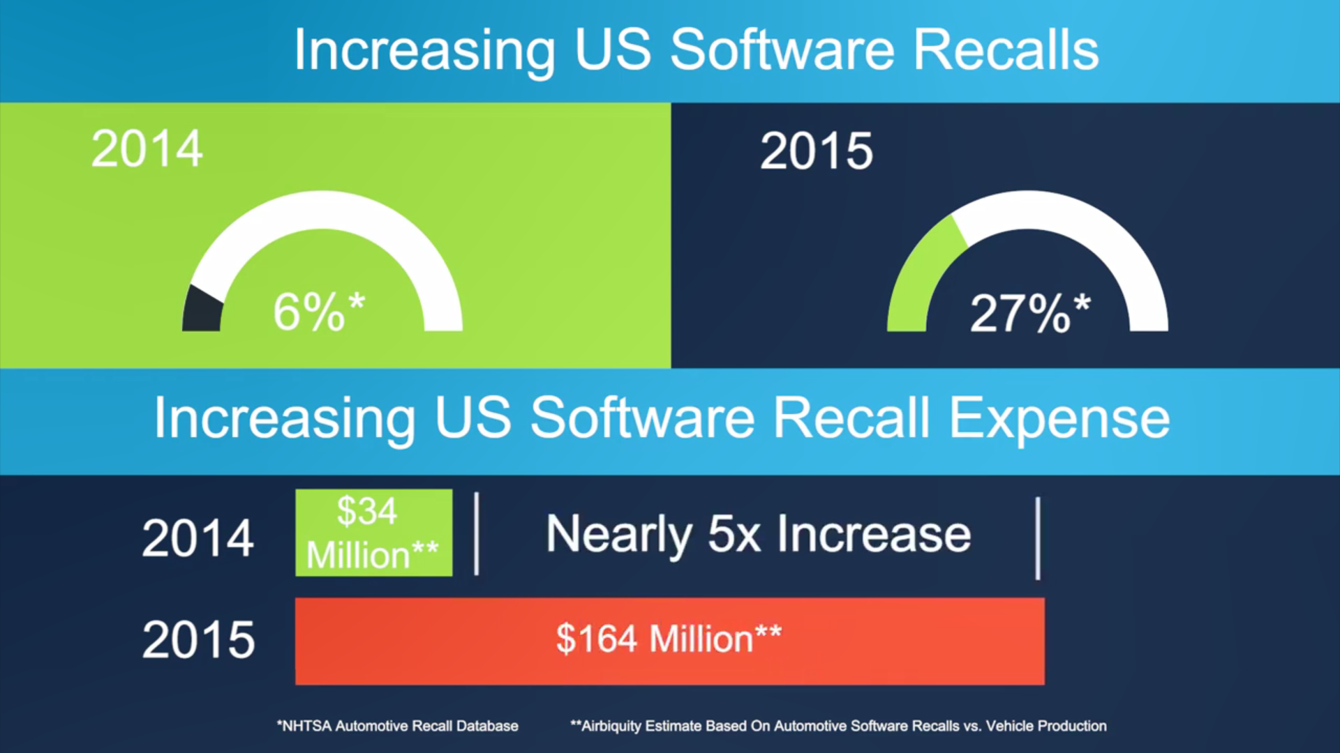
Introduction

Slide 9
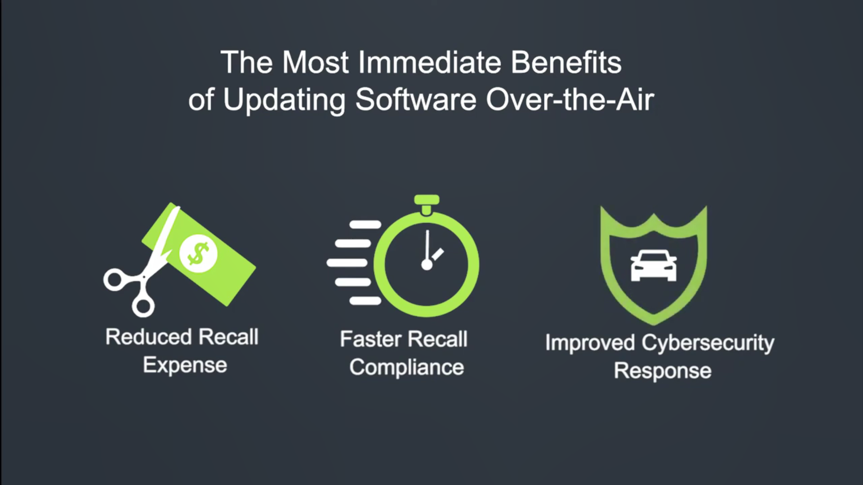
Introduction

Slide 10





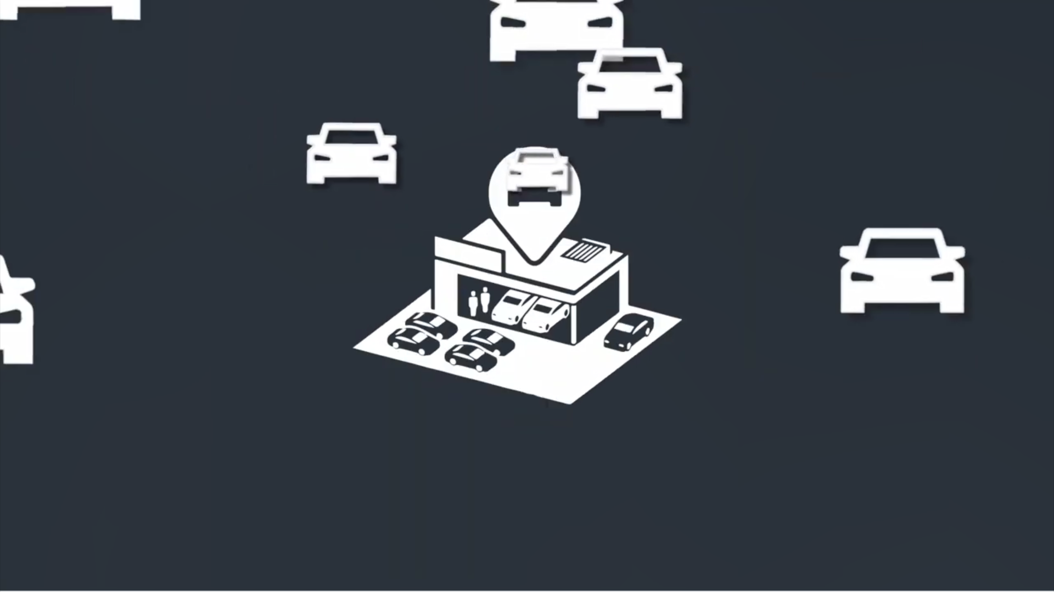
Introduction

Slide 11


Introduction

Slide 12
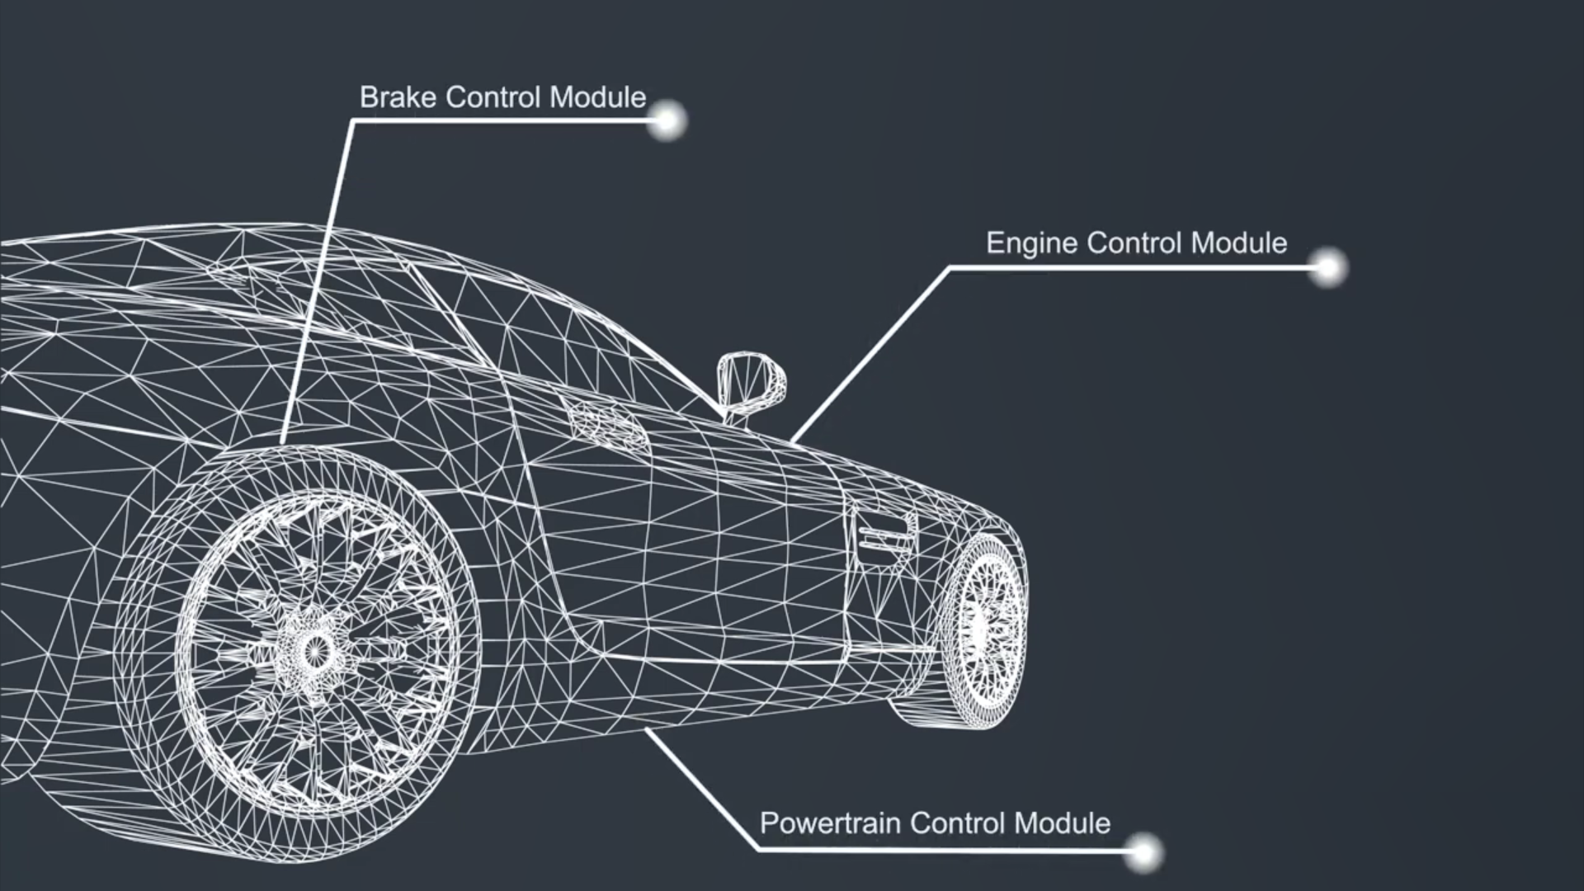
Introduction

Slide 13
System Overview

Slide 14







FOTA Services
CONTROL
Optimize operations while delivering a great customer experience
UPDATE
Keep devices updated over their entire lifecycle, without costly service trips
FIX
Firmware update facilitates bug fixing, enhancements, and security patch updates
SECURE
Secure system through data integrity and source authentication
OEMs

Slide 15

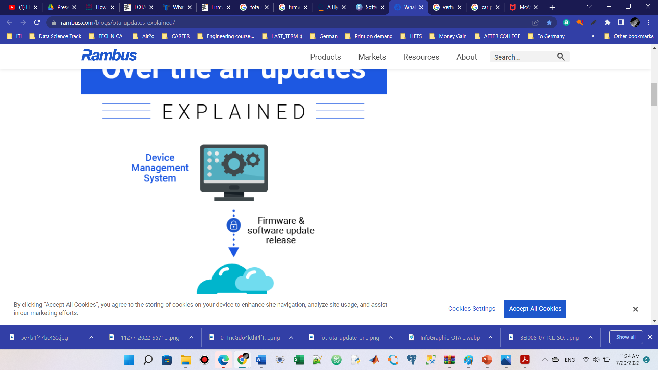
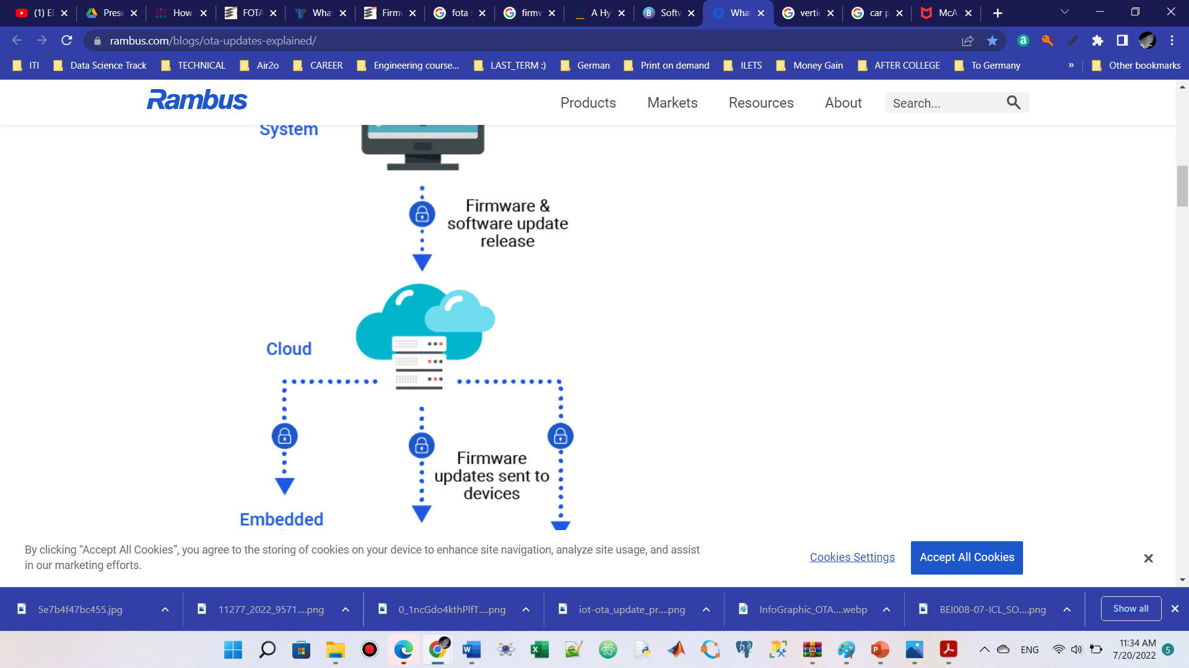

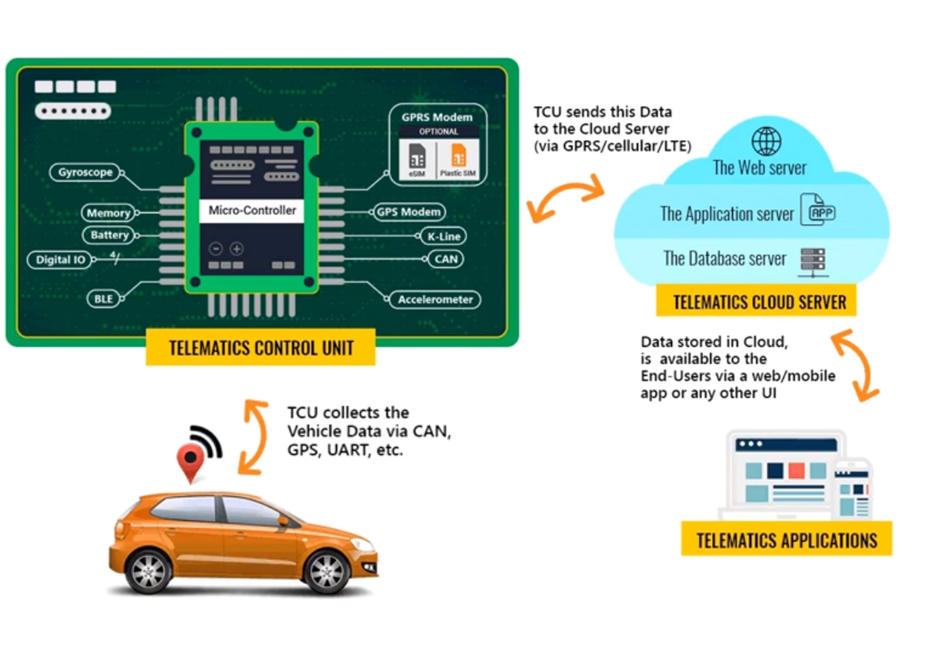
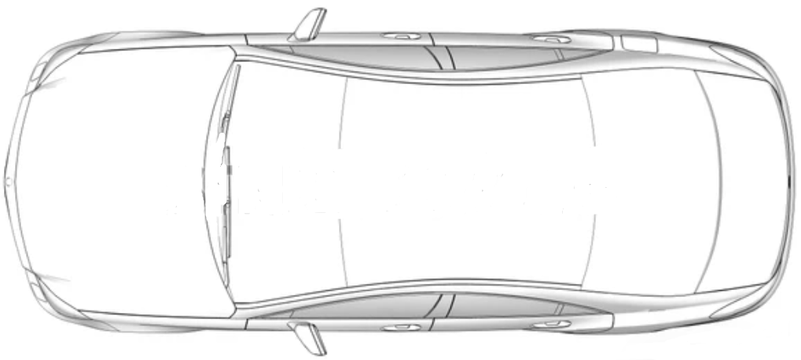

System Overview
Firmware & Software Update Release
where the users can get new updates for their systems or send diagnostics to get problems solved.
Provides the products with Firmware system
Backend server/cloud
Communication Protocols.
OEM Firmware Update Provider
Firmware Updates sent to devices
ECU
ECU
TCU
GW
ECU
ECU
Telematics Unit
It’s the bridge connecting the server and the whole system allowing to send and receive multiple data through it.
Gate Way
Connects between TCU and all the product ECUs, get important data from the received update before sending it to the target ECU like ECU ID
Electronic Control Unit
An embedded system in automotive electronics controls one or more of the electrical systems or subsystems.

Slide 16
System Overview
Is that all?
Flashing Techniques for Microcontrollers
Flash is a type of non-volatile memory; that is, it's a memory that keeps the information transferred to it even when the power to the microcontroller is shut off… We need to get our program there
Off-Circuit Programming
In-System Programming
(ISP)
Bootloader

Slide 17
WEB: Front-End

Slide 18





Slide 19
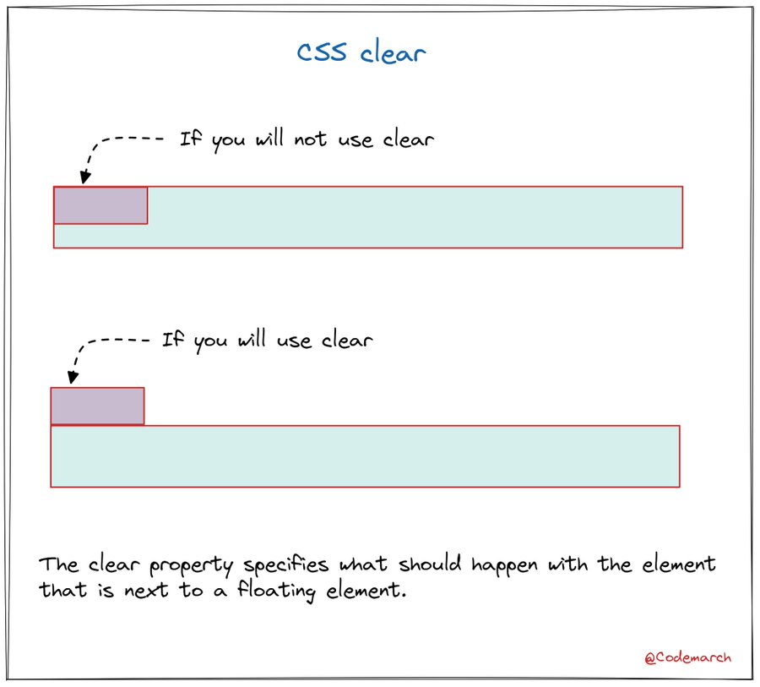
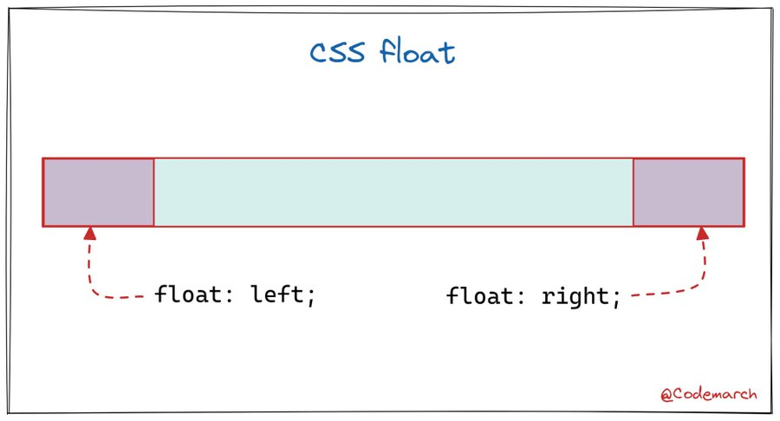

Slide 20
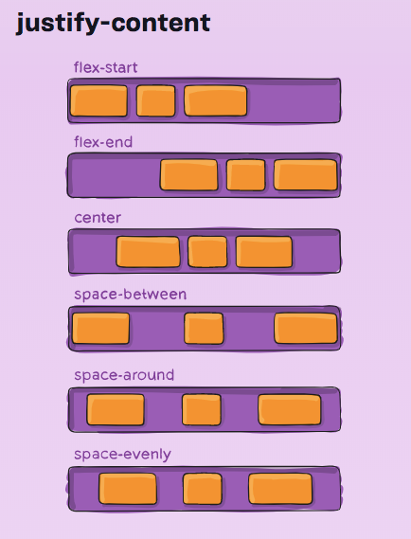
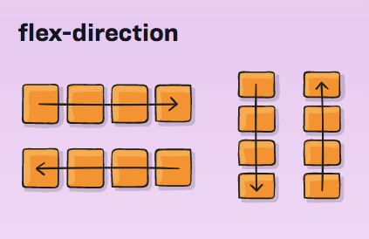

Slide 21
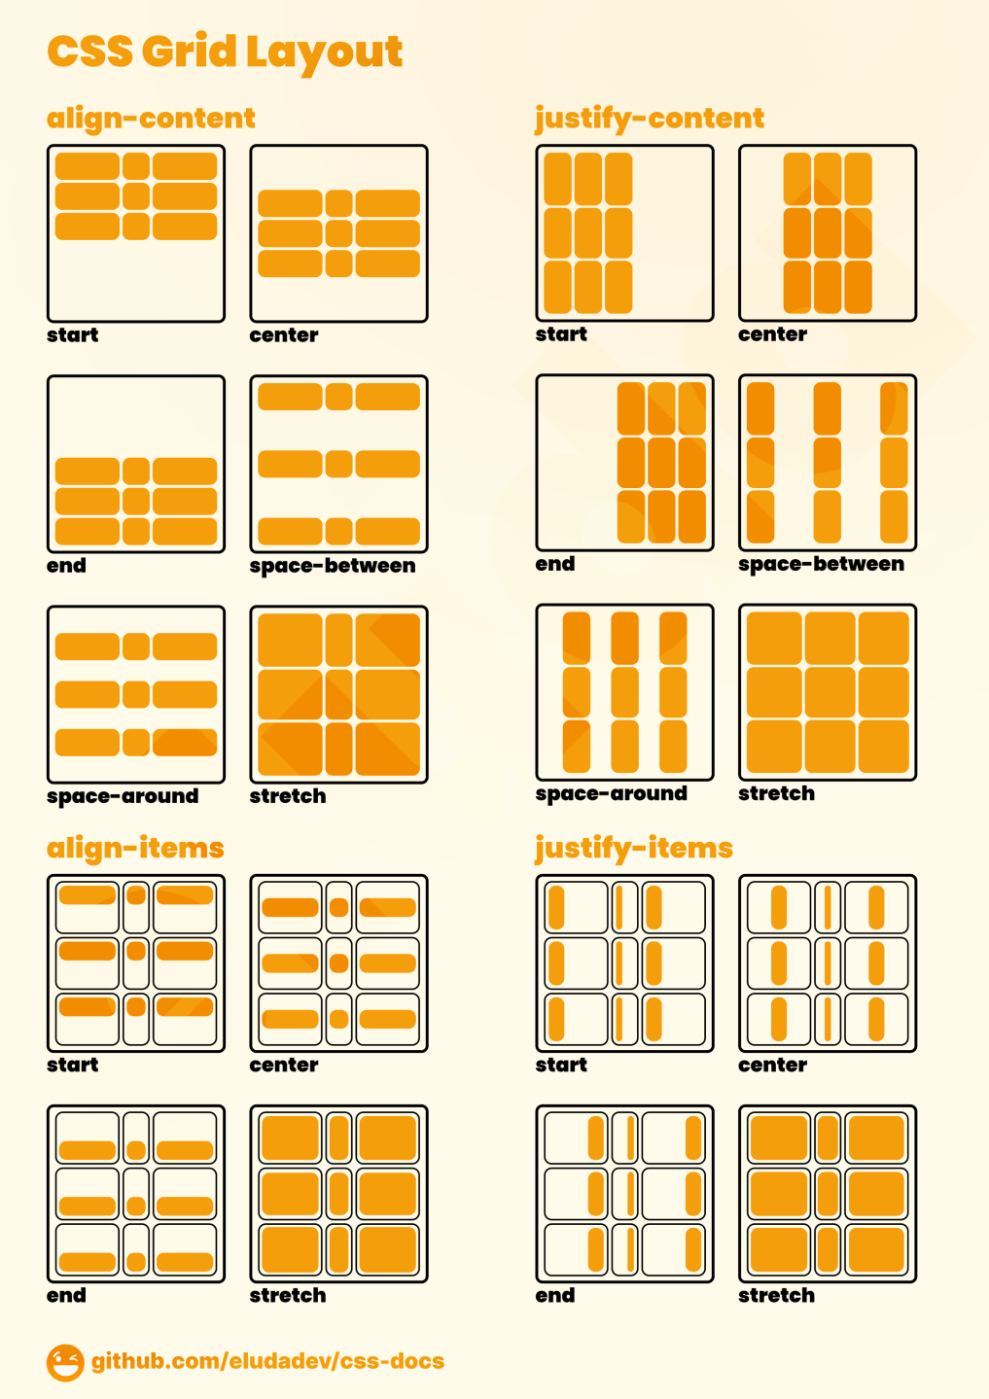
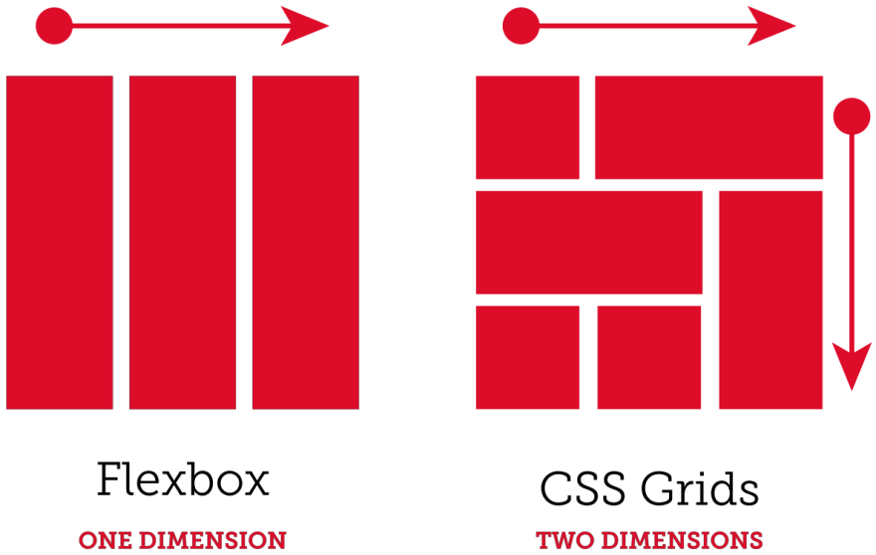
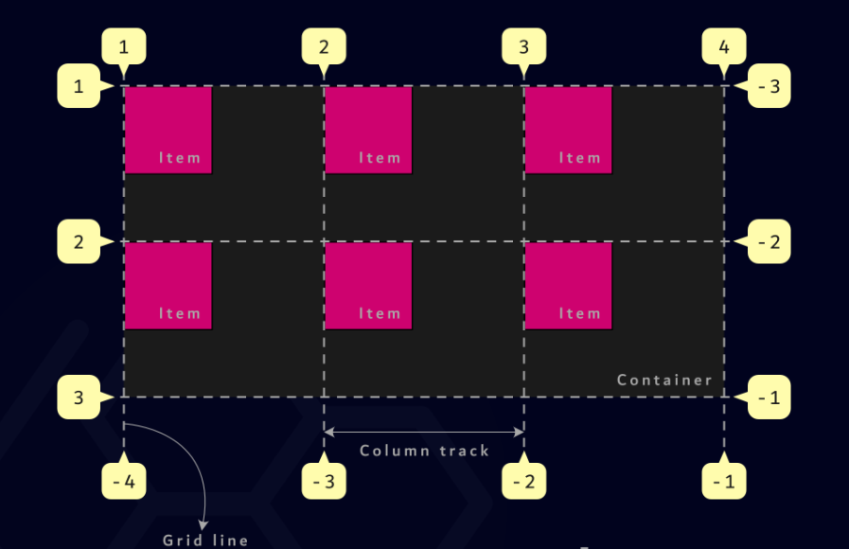

Slide 22
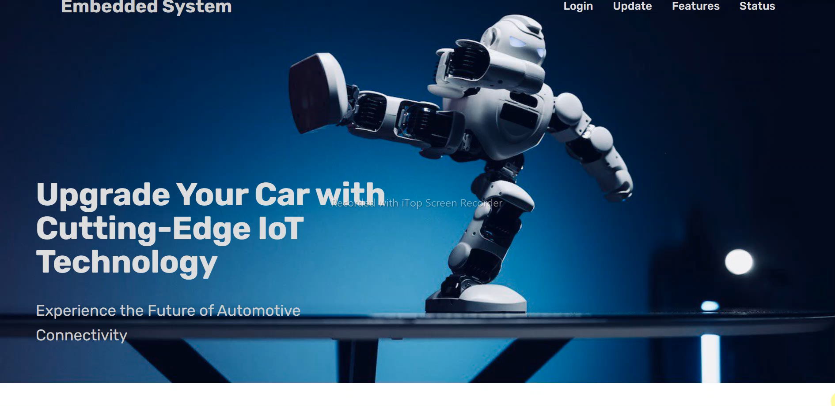
OVERVIEW

Slide 23
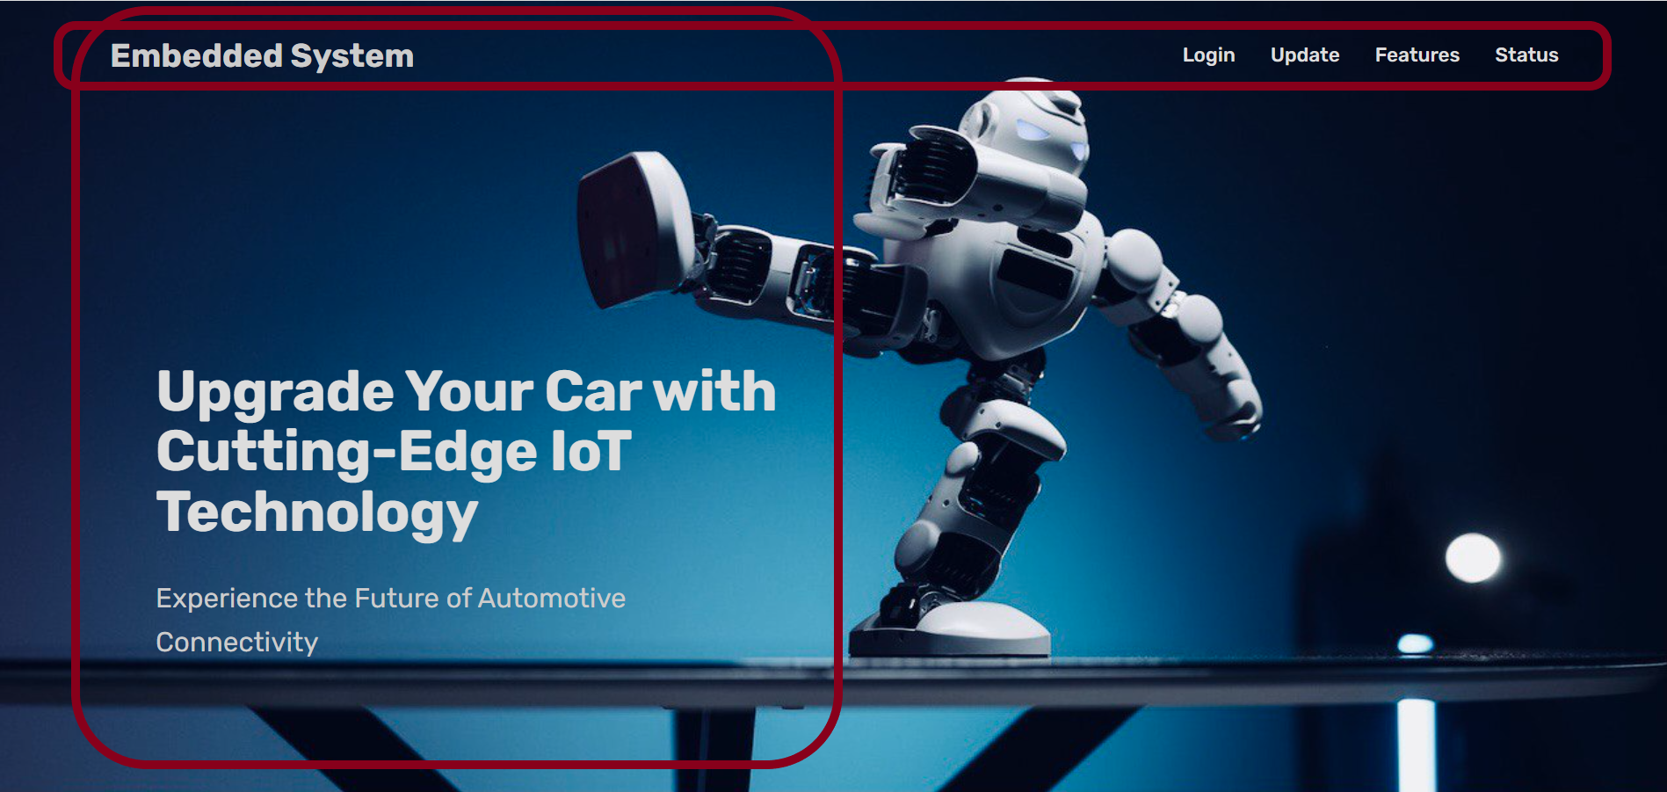


Slide 24
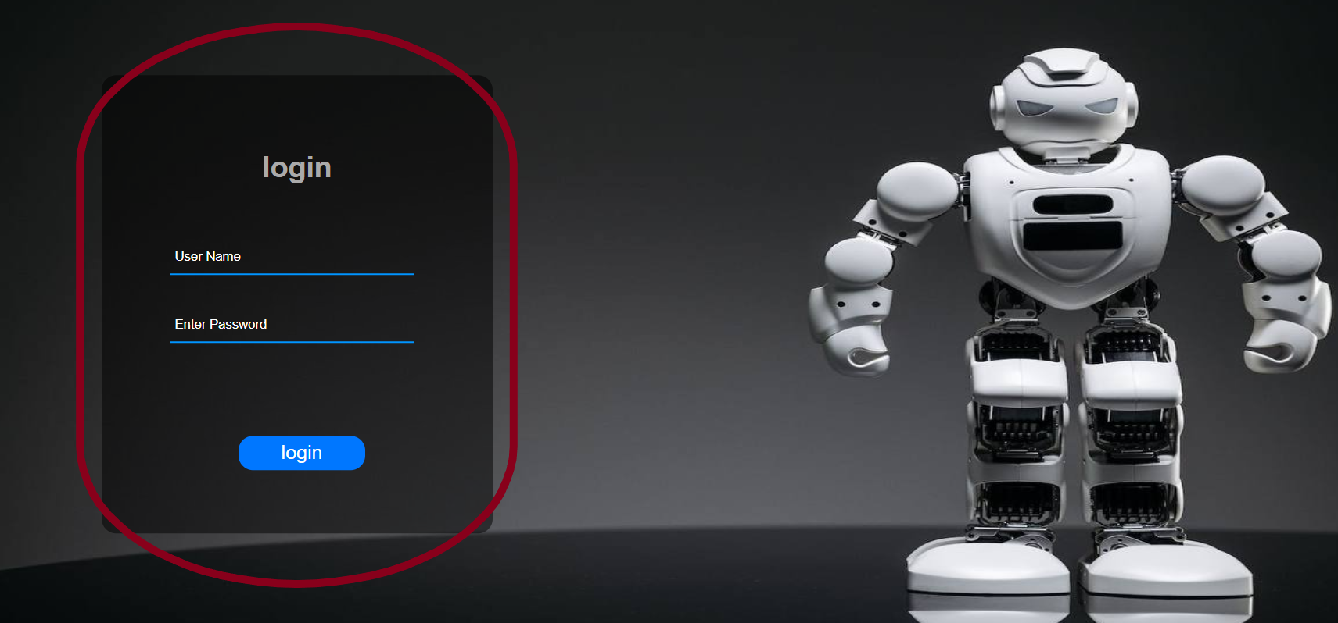

Slide 25
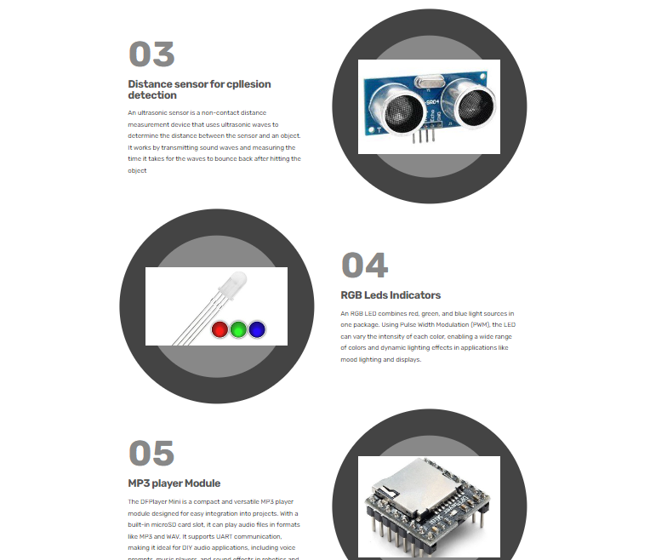

Slide 26
WEB: Back-End

Slide 27
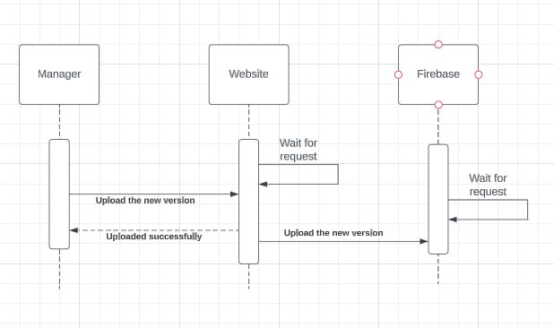

Slide 28
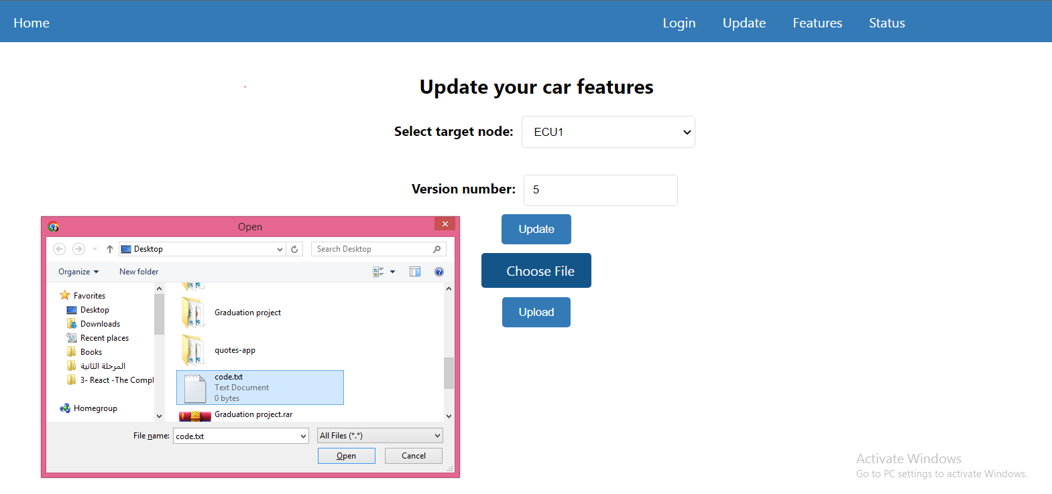
Update Page

Slide 29
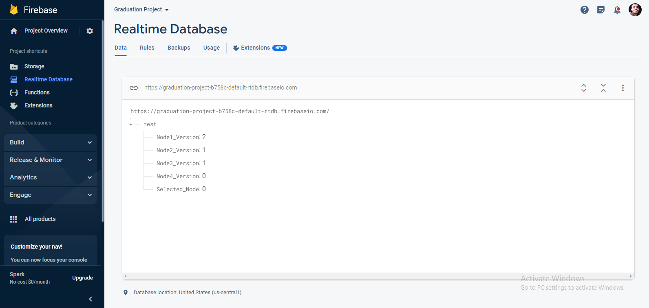
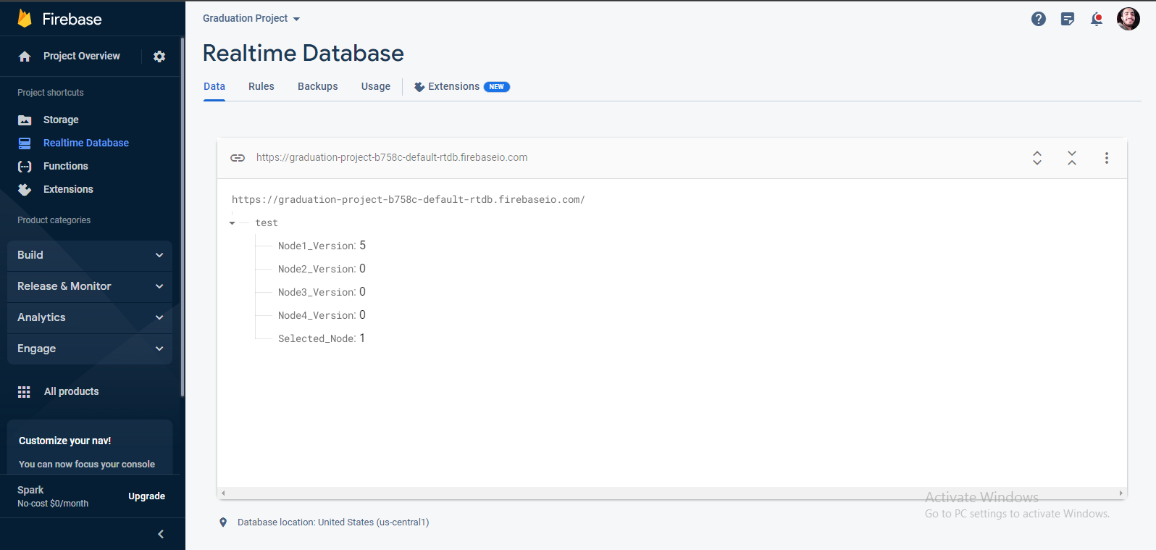
Firebase: Real-time Database

Slide 30
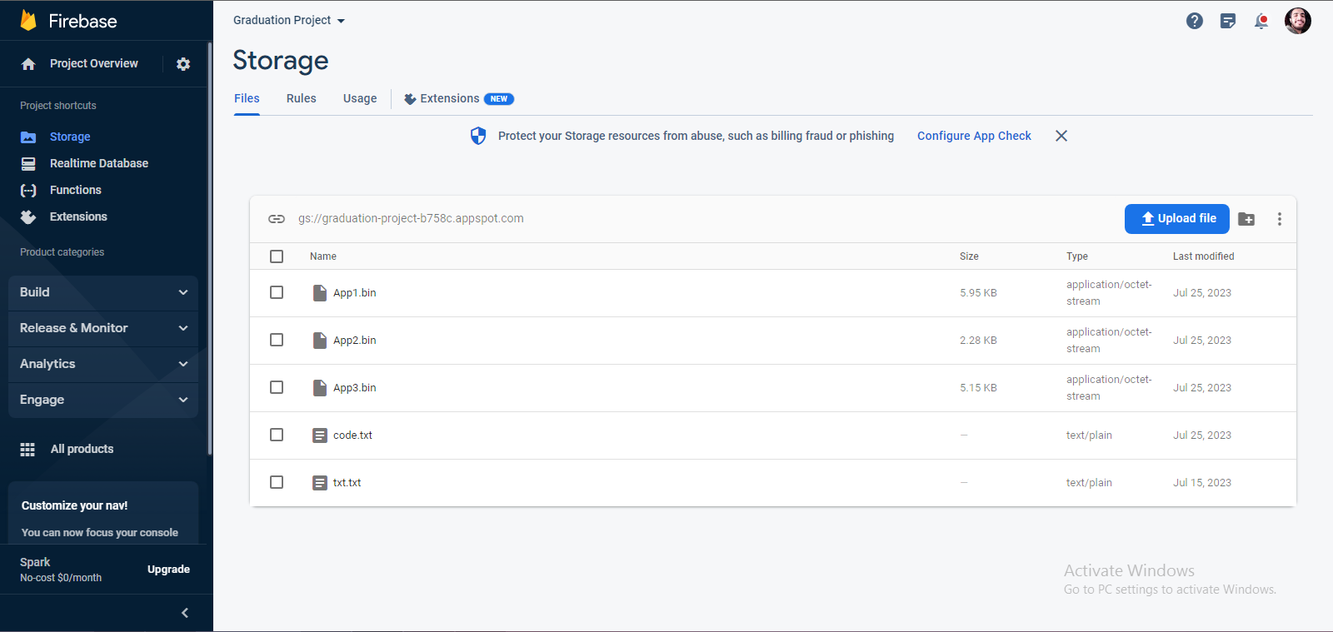
Firebase: Storage

Slide 31
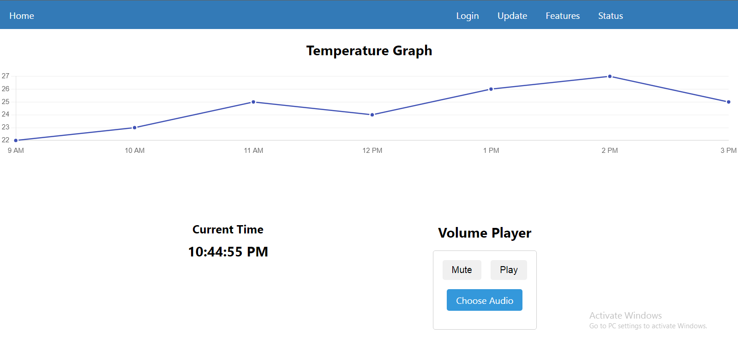
Firebase: Realtime

Slide 32
Security & Cryptography

Slide 33






What is cryptography
SenderSide
BLACK BOX
Plaintext
Cipher text
Transmission
RecieverSide

Slide 34
Why AES
 | RSA | ECC | AES 256
 | Long | Short | Medium
 | susceptible to quantum attacks using Shor's algorithm | offers excellent resistance to quantum attacks | quantum-resistant
 | Asymmetric | Asymmetric | Symmetric
 | AES 256 is the used algorithm.

Slide 35
AES Modes
 | ECB | CTR | CBC
 | block of plaintext is independently encrypted | Converts a block cipher into a stream cipher | Each plaintext block is XORed with the previous ciphertext block before encryption. Interdependency between blocks.
 | Identical plaintext blocks will result in identical ciphertext blocks | Parallelizable and allows for efficient encryption/decryption | initialization vector (IV) for the first block is required.
 | Does not provide any mechanism for error propagation | padding isn’t required | Require padding
 | Vulnerable | Suitable, efficient and secure. | Better security that ECB

Slide 36
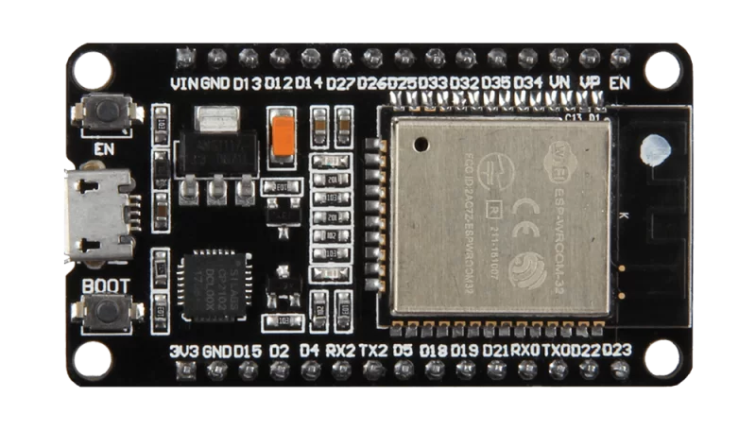







Main Characteristics
Why AES

Slide 37
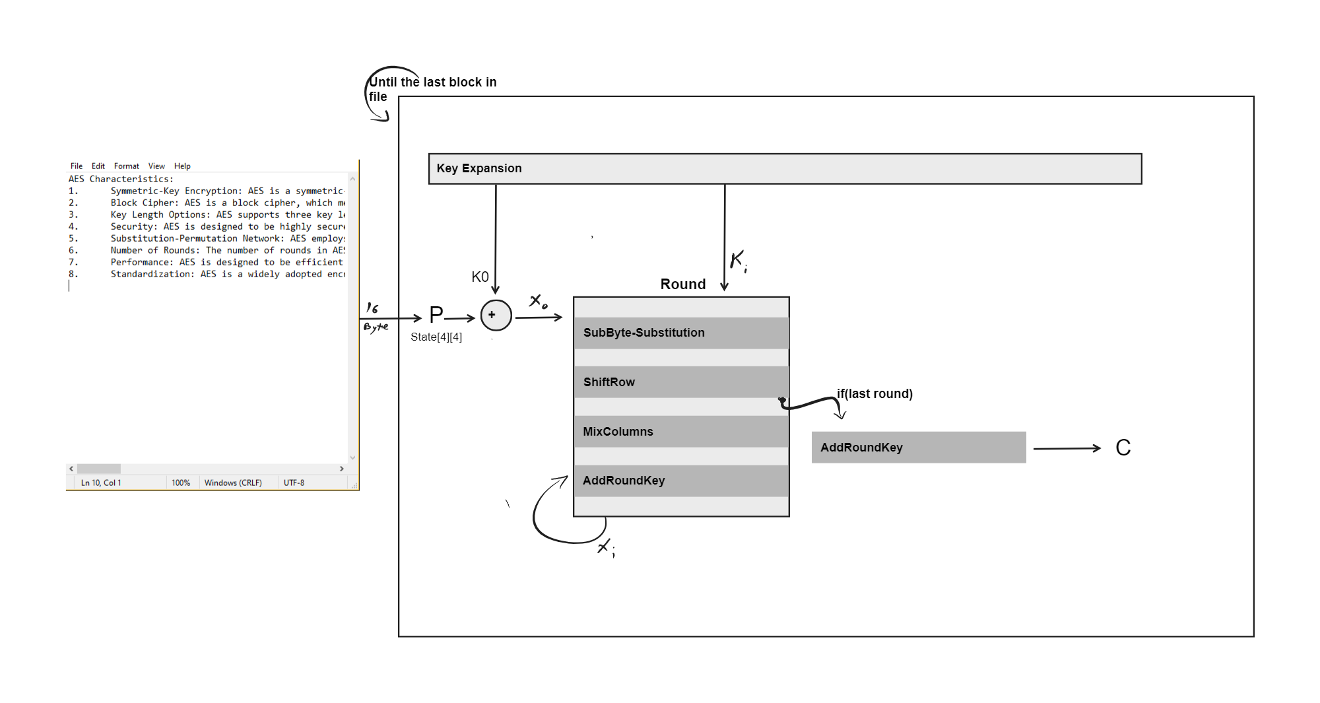
Black-Box
ق | 0 | % | ً
 | ہ | z | {
 | à | k | M
j | [ |  | J
 | S | E | A
r | a | h | C
e | t | c | a
t | s | i | r

Slide 38


Example of Encryption

Slide 39
Server

Slide 40

Firebase
Firebase is a Backend-as-a-Service (Baas). It provides developers with a variety of tools and services to help them develop quality apps
Firebase is categorized as a NoSQL database program, that stores data in JSON-like documents.

Slide 41
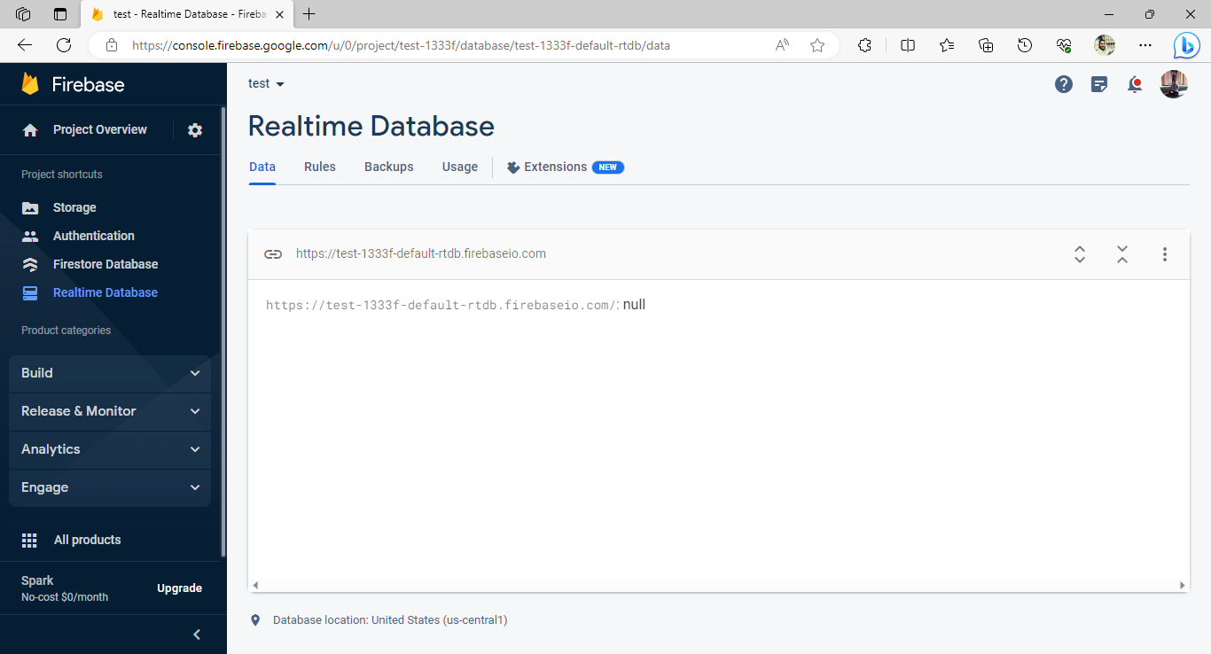
Realtime Database
The Firebase Real-time Database is a cloud-hosted NoSQL database that enables data to be stored and synced between users in real-time.

Slide 42
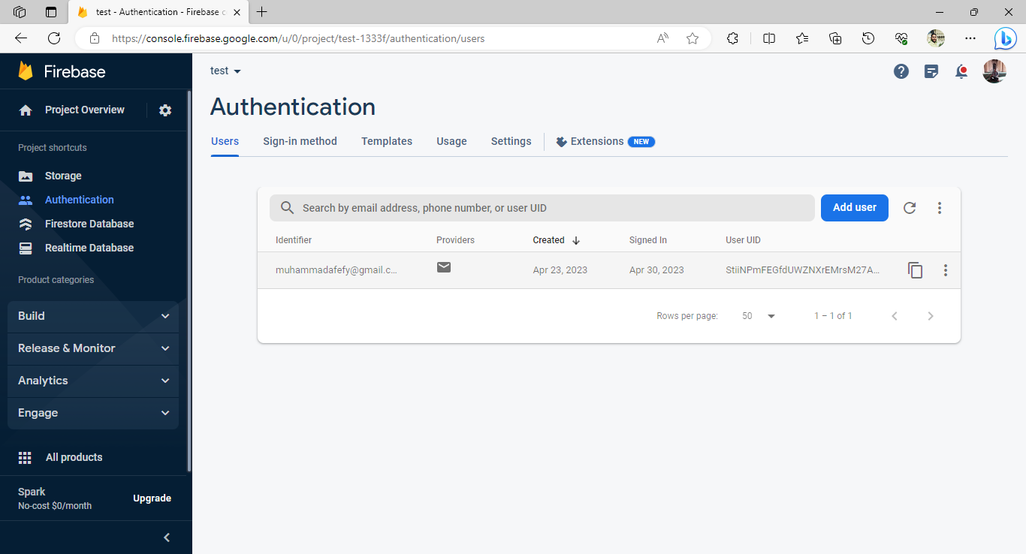
Authentication
Firebase Authentication makes it easy for developers to build secure authentication systems and enhances the sign-in and onboarding experience for users.

Slide 43
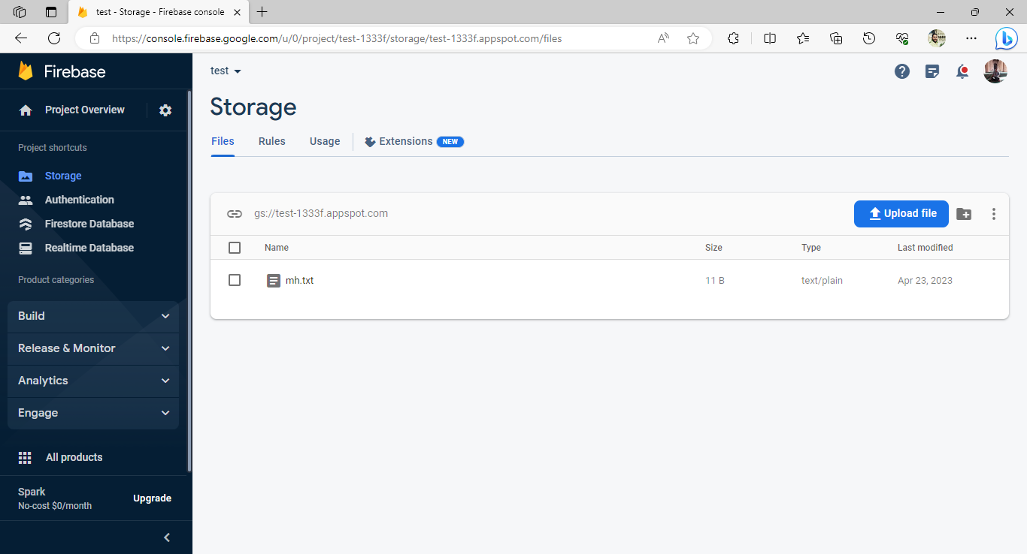
Storage
Firebase allows us to store files like the software update to access them later and download it.

Slide 44
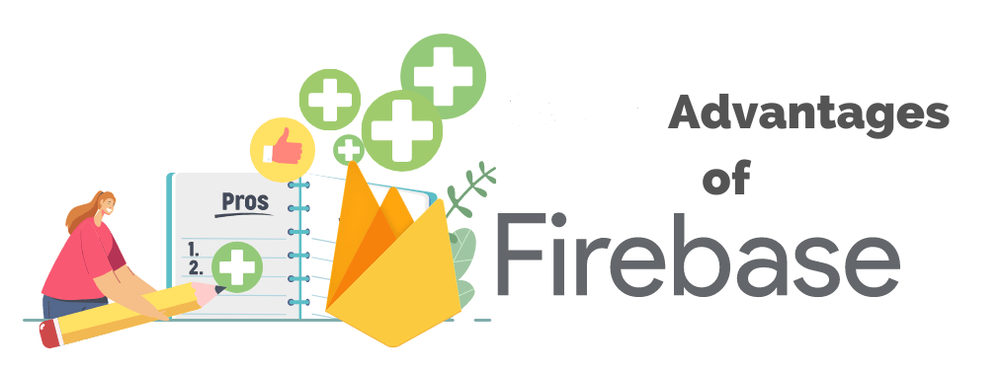
Firebase Pros
Faster App Development
Hosting
Performance Monitoring
Extensive Documentation
Analytics
Serverless Platform
Cloud Firestore
Easy Integration

Slide 45
ESP
The ESP32 is a popular and versatile microcontroller, It is widely used on the Internet of Things (IoT) and embedded systems projects due to its powerful features and built-in connectivity options.

Slide 46
Why ESP32?
Wi-Fi and Bluetooth Connectivity
Built-in Peripherals
Low Power Consumption
OTA (Over-the-Air) Updates
Open-Source
Large Community and Support
Extensive Development Frameworks

Slide 47
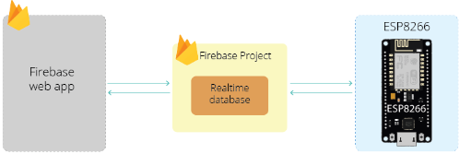
ESP with Firebase
ESP is used to store and read data from the database

Slide 48
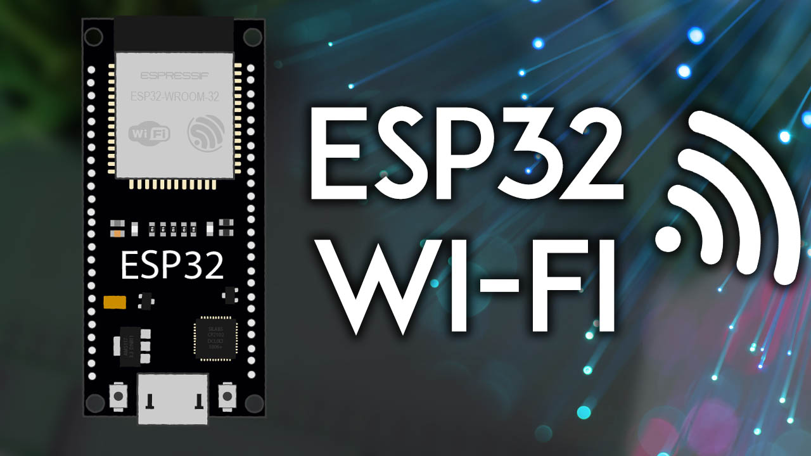
ESP Wi-Fi
The ESP32 are readily available Wi-Fi modules with full TCP/IP stack and microcontroller capability.

Slide 49
ESP32 Wi-Fi networking functionality
Station mode (aka STA mode or Wi-Fi client mode). ESP32 connects to an access point.
AP mode (aka Soft-AP mode or Access Point mode). Stations connect to the ESP32.
Station/AP-coexistence mode (ESP32 is concurrently an access point and a station connected to another access point).
Various security modes for the above (WPA, WPA2, WPA3, etc.)
Scanning for access points (active & passive scanning).
Promiscuous mode for monitoring of IEEE802.11 Wi-Fi packets.

Slide 50
CAN Protocol

Slide 51
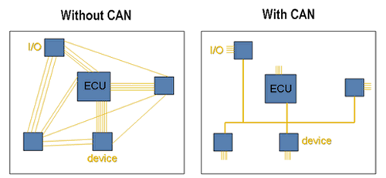
CAN Network
Controller Area Network

Slide 52
CAN Features
Low Cost
Speed
Multi-Master
Message based, not address based
Built-in Error Detection
Stable

Slide 53
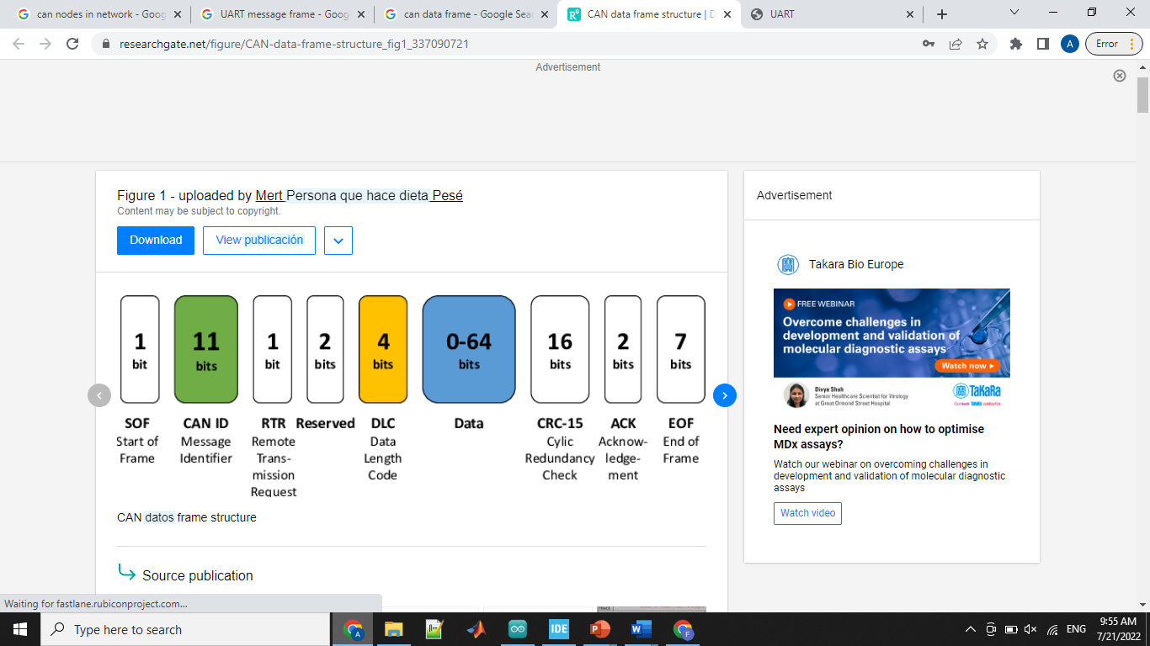
Message Types
Data Frame
Remote Frame
Error Frame
Overload Frame

Slide 54
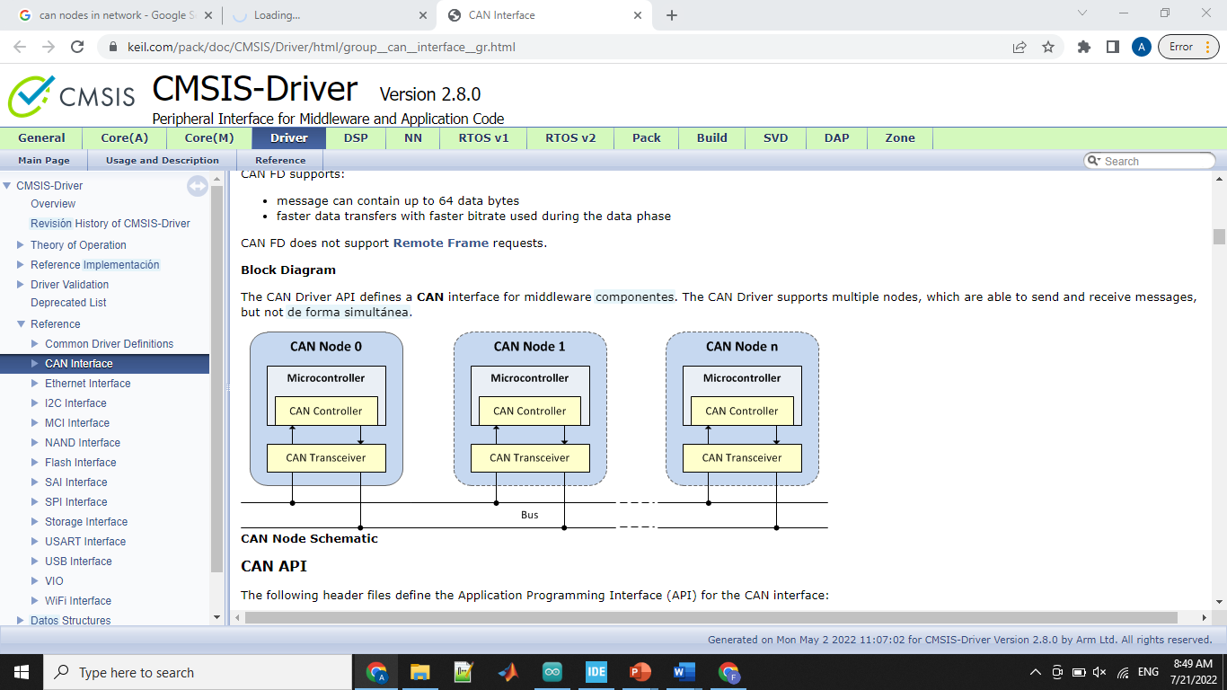
CAN Interface

Slide 55
CAN Operation
Message Transmission
Identifier List Mode
Message Filtering
Identifier Mask Mode
Message Reception

Slide 56
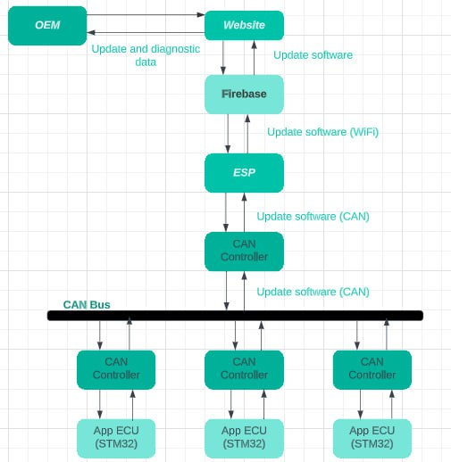

Slide 57
Bootloader

Slide 58
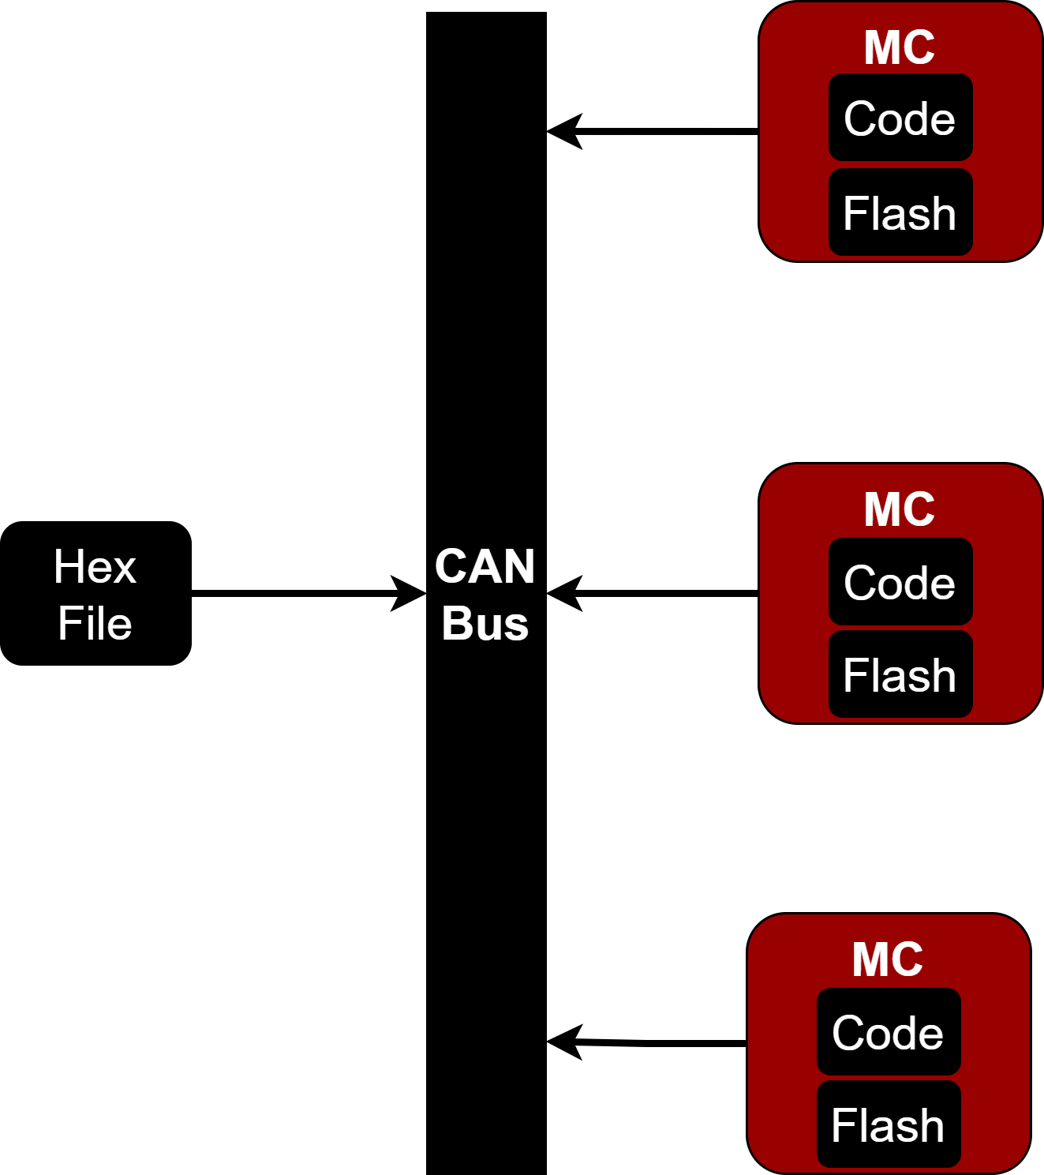
Bootloader
Solving The Problem.
Bootloader.

Slide 59
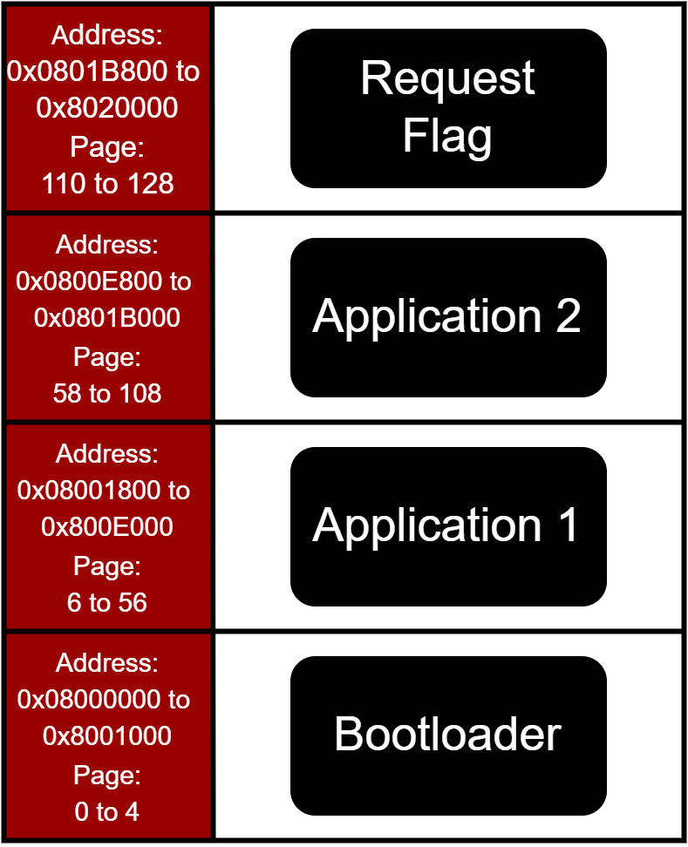
Bootloader
Memory Hierarchy

Slide 60

Bootloader
Scenarios

Slide 61

Bootloader
CRC Check

Slide 62

Bootloader
Update Complete

Slide 63

Bootloader
Data Corruption

Slide 64
MAIN ECU

Slide 65


MAIN ECU
Main Functions of Main ECU
Telematics Unit
Gateway Unit
Receive Update Request
Check for Update Version
Download Update File
Decryption of File
Send Update File
Handling of communication traffic between multiple ECUs
Send downloaded file to APP ECU
Receive diagnostics data

Slide 66




MAIN ECU
Components of Main ECU
STM32 BLUE PILL
TFT diplay

Slide 67





MAIN ECU
Steps of Downloading Update File
Server Authentication / Connection with Server
Check Update Version / Download Update File
Providing API key and server authentication credentials to connect to server and allow access to fetch data.
Check version of update file from server RTDB and download file from the database and save it to SPIFFS.
Send file to Gateway using UART
Decryption of Update File
We use UART communication protocol to send data after receiving an acknowledgment to send the frame required.
Read file line by line then decode it using Base64 and decrypt each line using AES method.

Slide 68
USER INTERFACE

Slide 69



Touch Screen

Slide 70

Touch Screen

Slide 71

Touch Screen

Slide 72


Touch Screen

Slide 73

Touch Screen

Slide 74

Touch Screen

Slide 75
APP ECUs
STM32

Slide 76




APP ECUs

Slide 77
Hardware

Slide 78

Hardware

Slide 79
Video

Slide 80
Future Work

Slide 81
Future Work
-Embedded LINUX
-RTOS
-AUTOSAR Layered Architecture

Slide 82
THANK YOU

